Slide 1
RNA velocity of single cells
Notes:
https://www.nature.com/articles/s41586-018-0414-6

Slide 2
unspliced / spliced
cellular dynamics
cell differentation
lineage decision
apply to human

Slide 3
Balance between unspliced and spliced mRNAs is predictive of cellular state progression

Slide 4
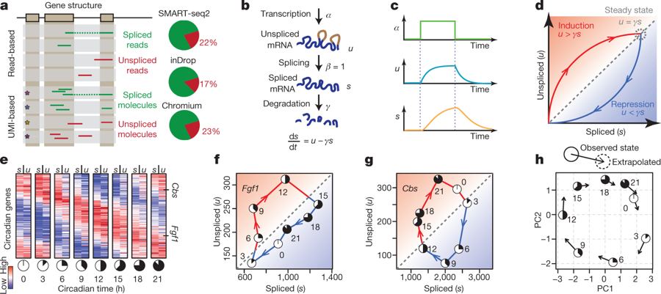
~20% reads: unspliced intronic
correlate with exonic reads
unspliced precursor mRNA
confirm: metabolic labelling STRT

Slide 5
upregulation: u↑ ，s↑

Slide 6
unspliced RNA predictes spliced mRNA at the next time point
三羧酸循环

Slide 7
Fgf1
Cbs

Slide 8
RNA velocity recapitulates dynamics of chromaffin cell differentiation

Slide 9
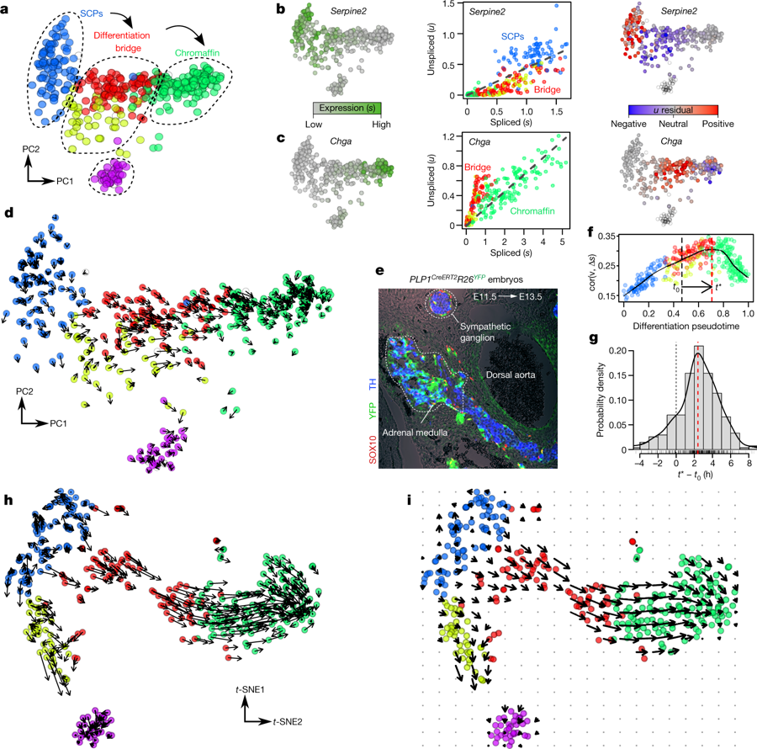
SCP differentiating -> chromaffin

Slide 10
repressed
induced
spliced expression
Phase
unspliced residual

Slide 14
RNA velocity field describes fate decisions of major neural lineages in the hippocampus

Slide 15
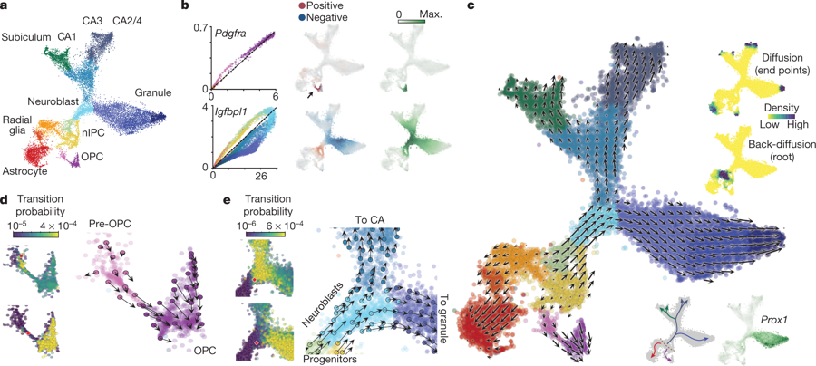
PCA
Single cell

Slide 16
Pre-OPC -> OPC
Pdgfra induced
Phase
unspliced residual
spliced expression

Slide 17
Maekov walk find tip and root

Slide 20
Kinetics of transcription during human embryonic glutamatergic neurogenesis

Slide 21
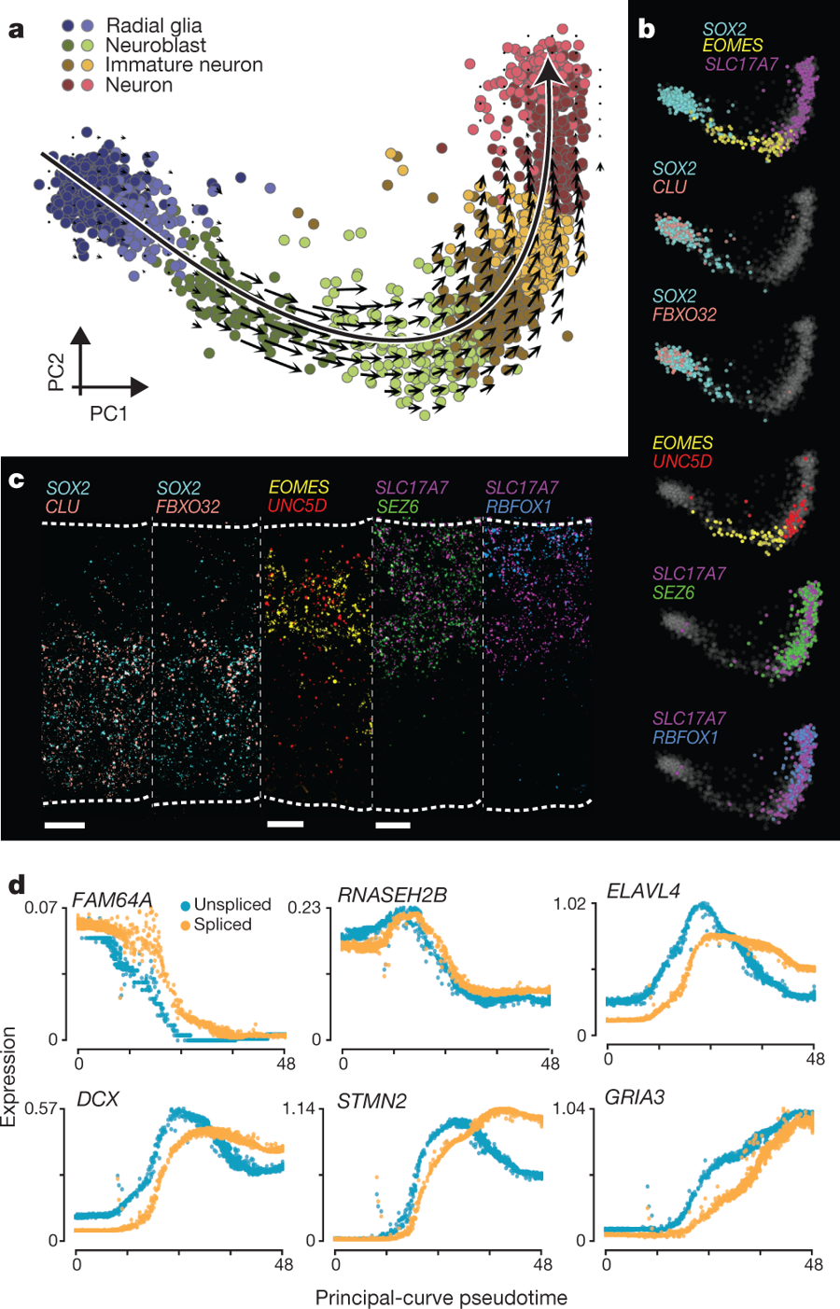
human neuronal lineage

Slide 22
confirm predicted expression

Slide 24
unsplice preceded splice

